Slide 1
Oracle Indexes
Btree and Bitmap

Slide 2
What is Index?
The point of indexing is to improve database performance.
An index is an structure that exists inde[pendent of the data in your table that improves the query optimizers ability to execute your query quickly.
If we want to find something specific instead of going through the whole table we can use index to help with our searches.

Slide 3
Understanding Indexes
An index is a pointer to the data in the table.
Think :Index is the back of a book
The Book is printed in page order.
The index represents that same book in a different, it represents it in keyword or subject order .
Most of the time you're going to create a table in a database and it is going to be in a certain order based on the primary key however there are times that you need to get to that data and query that data in a different order so you may have it in order by the order date but you may want a query from time to time about the particular customer who sold that order.

Slide 4
Understanding Indexes
How do we find that and how does that exactly work.
Well the index makes finding that data much faster and much more efficient but when we've got an index in the back of the book it helps us find any subject matter really quickly however if we go in and add two or three pages to that book we've now changed our index every page after that change that we made the index is probably wrong now and the page numbers need to be changed.
The same thing happens with our tables when we put an index on a table and then change the data in that table it's going to inevitably change some of the index values and they're going to have to be rebuilt or reconstructed.

Slide 5
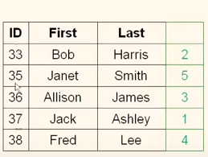
Quick Example
We have got a table storing people's first and last names.
You will notice that this table is in the ID order for whatever reason.

Slide 6
Quick Example
This table has been put in ID order but we need to query this table from time to time based on the last name and so what can we do.
Create an index on the last name now this is a bit confusing.
Notice the index is on the last name but the numbers in green are the actual indexes and they are the pointers.
What this is telling us is hey if this table was in the last name order this is the order that the table would appear in.
So let's take a look at the way SQL can now see this table.
Same data it just sees it in a different order now.

Slide 7
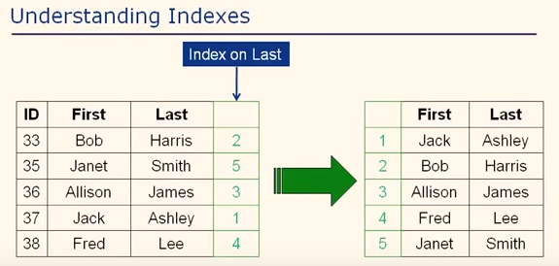
Understanding indexex

Slide 8
How does this help?
When we query based on last name and we want to only find Alice and James when I look for James this way we can't tell by looking at the last name, when order it's in and so we don't know if we have more than one person in our database with the last name of James
So we have to scan all five rows now if this was a million rows we would have to read all million rows because we don't know if there's another James however in this table since we know that it is in last name order right it's an alphabetical order actually Harris James Lee Smith
Now when we tell it to return us everybody with last name James it know that it can start and go down and once it sees James it can return it and once it finds the next record that is no longer James it can stop it doesn't have to check any further because it's in that particular order and it knows it just reached the end of that range and there are no more James in the database.

Slide 9
How does this help
What we've done is we've allowed it to limit the number of records that it has to look at to satisfy our query that's the big advantage with indexes.
Now keep in mind though the big problem with indexes is if we come in here and add someone you know add an ID 39 and their last name is say brown then that is going to change the indexes for all of these people because Browns going to show up right here is number two Bob Harris becomes three Alice and James becomes four and so forth and so that index is going to have to be rebuilt or adjusted if you will to make sure that it's now correct.

Slide 10
How does this help
So here's the bottom line indexes would drastically speed up some queries and it can slow down even drastically slow down the process of inserting data and updating data in your table because those index numbers have to be maintained.

Slide 11
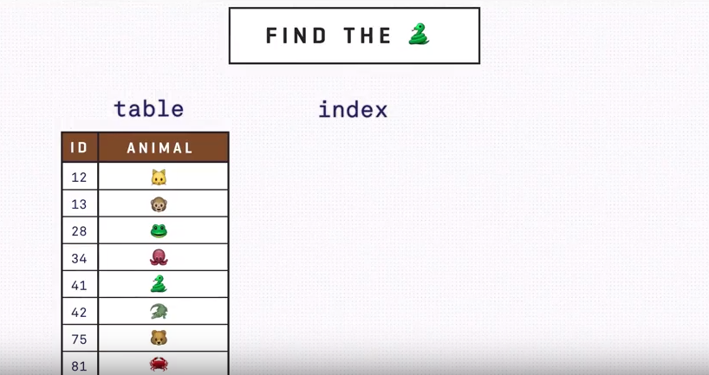
How can Index help ?

Slide 12
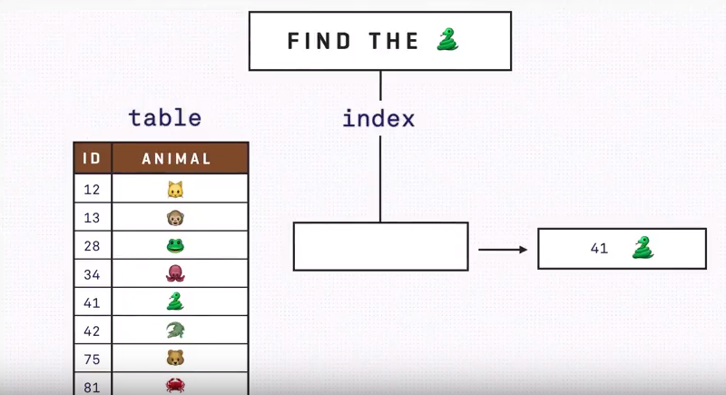
How can index help -2

Slide 13
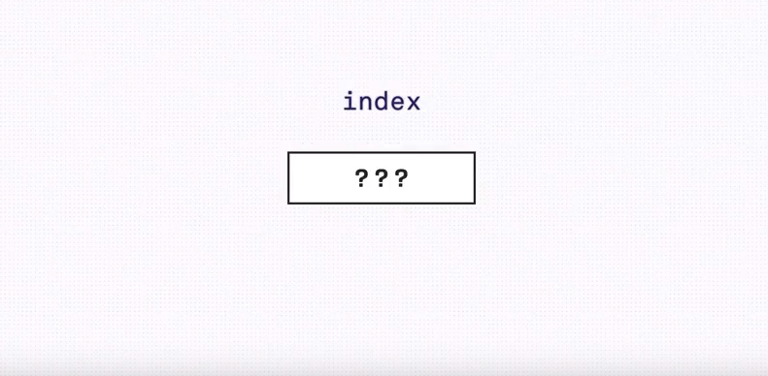
How does this work

Slide 14
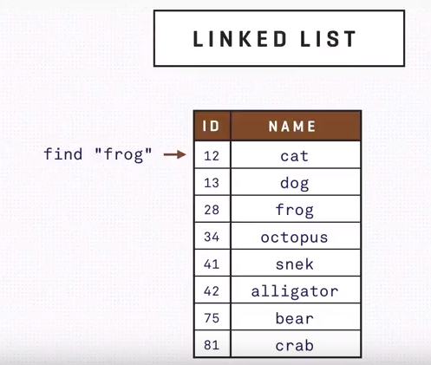
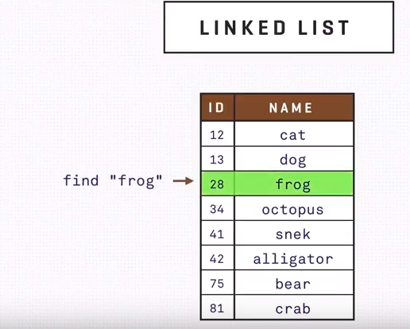
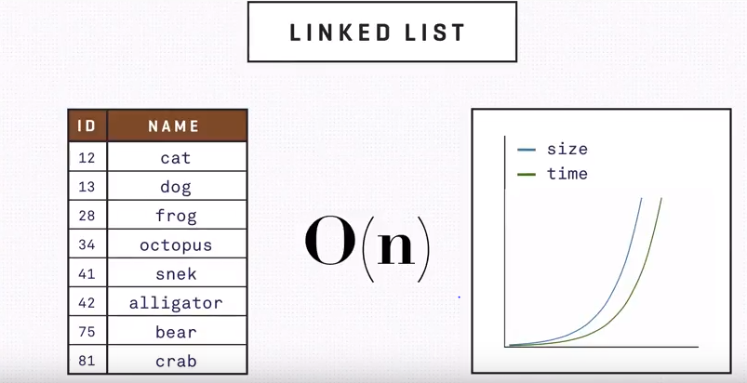
Linked table
Whenever we store the table as a linked list whenever we have to find an item we would have to traverse the list until we find one .On average we have to traverse half of it and the more items we have the more we have to look through which is called linear complexity or big O of n which simply means the time it takes to look something up grows twice is the datasets doubles.

Slide 15
How can we improve
How can we improve that time if we sacrifice in something else.
Lets try using separate structures to store where the data is for example binary search tree.
We can choose a root and put our elements before and after the root then as our database grows it’s easier for us to locate our elements as we don’t have to traverse the whole tree.
Now the time it generally takes to find an item does not rise that quickly as not it performs what is called logarithmic time.
Now if the dataset doubles the search time increases by a linear factor this is much better that list traverse.

Slide 16
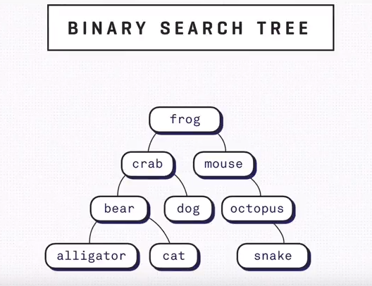
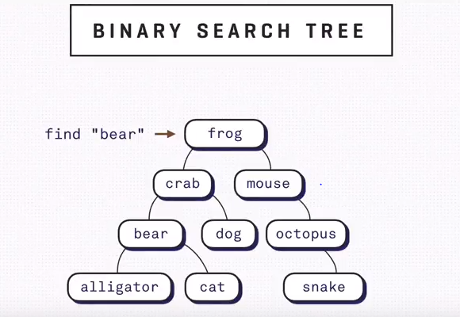
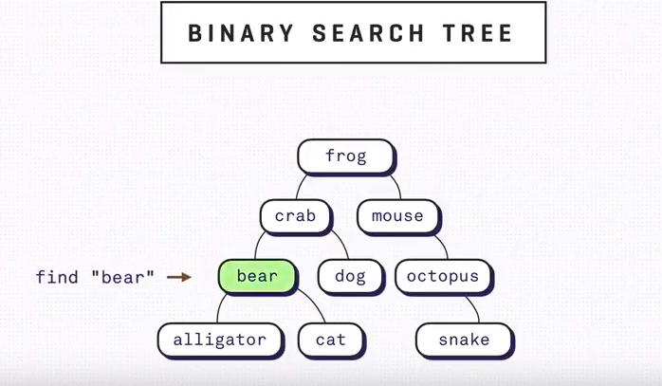
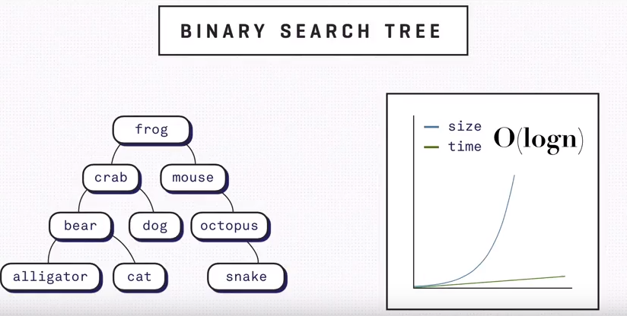
Binary Search tree

Slide 17
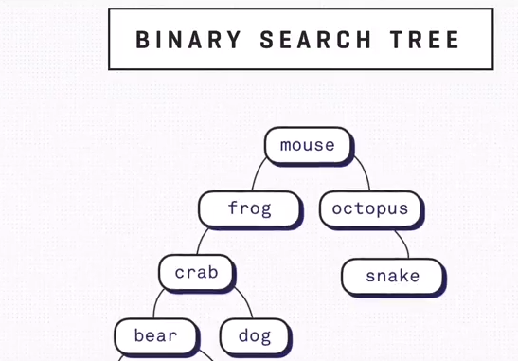
Unbalanced tree
If we have more elements on one of the branches we will have an unbalanced tree.
The worst case scenario is we will still have to traverse all the nodes to get what we want .

Slide 18
Can we do something about it
What can we sacrifice to optimize the search?
We can trade off some time it takes to add items to the tree.
Whenever we insert a new record into a tree we can choose a new root in such a way that the height of the tree remains same for all the branches.
There's one more practical thing to consider, this act is expensive so we want to do that as rarely as possible to achieve
To achieve that we can store several elements per node in a sorted way this is called a page when traversing the tree you access the disk only to receive the pages
Instead of individual elements the page has a fixed maximum size when you add a new element to the page ,and if it becomes larger than the limit the page needs to be split and the tree then rebalances this data structure is called a b-tree.

Slide 19
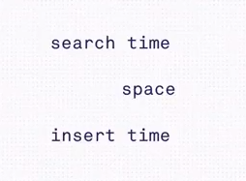
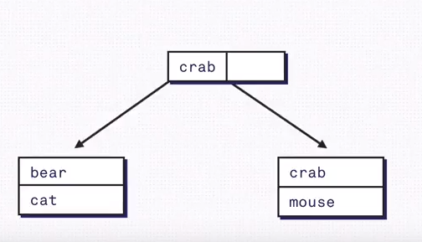
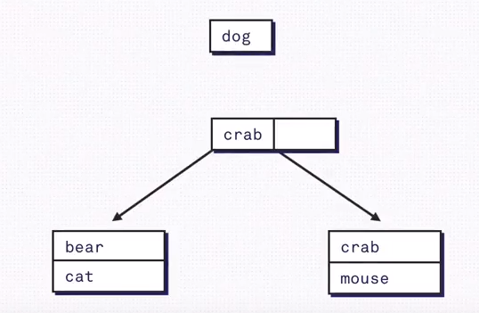
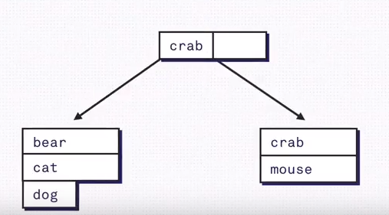
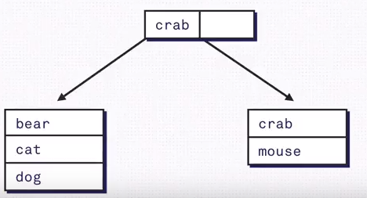
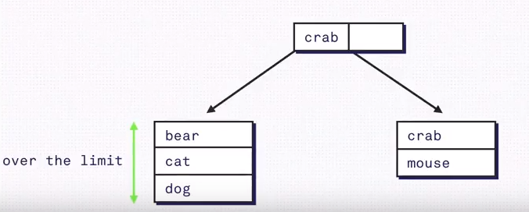
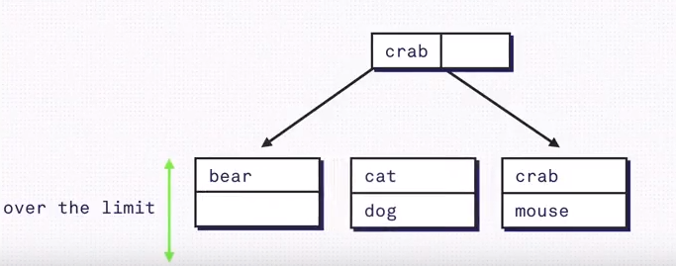

Slide 20
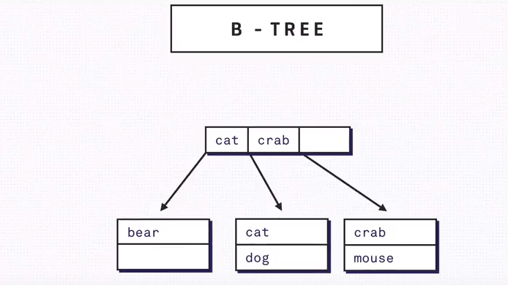
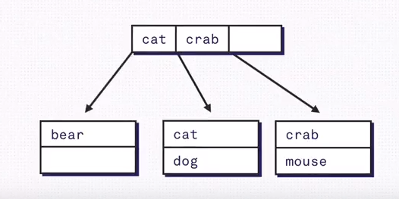
Balancing the tree is the cost we have to pay with every insert

Slide 21
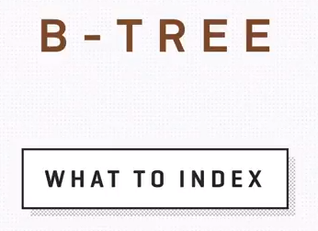
What to Index

Slide 22
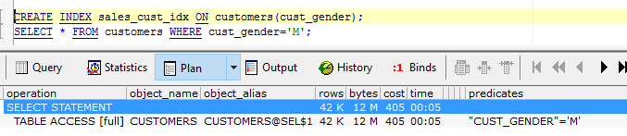
What to index?
If we add an index to a boolean column the tree will contain two large branches the storage engine would still have to traverse a list of pages on the true and false sign the index doesn't really help here.

Slide 23
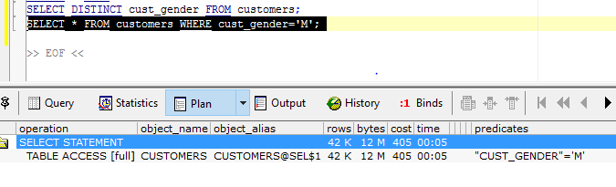
What to Index?

Slide 24
What to index?
let's say you add an index to a column containing very different data like Customer id , it will result in a tree that has to be rebalanced often since the insert goes to very different pages causing to the split so if you're doing more inserts on random data perhaps a primary key index is not the best as the index has to be updated every time the data is updated.

Slide 25
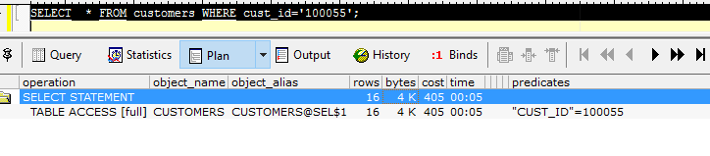
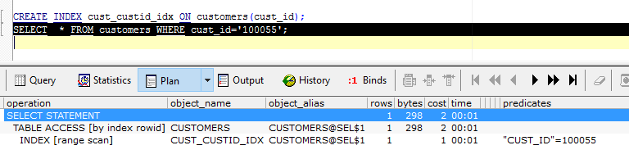
What to index

Slide 26

Index vs search

Slide 27
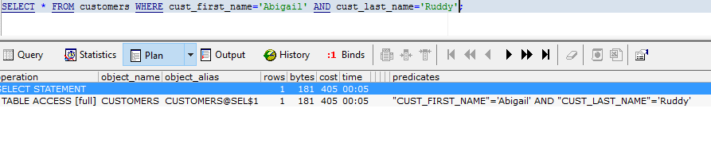
Index vs search
If we have a composite index on the first name and last name searching for a concatenation of both will not hit the index.

Slide 28
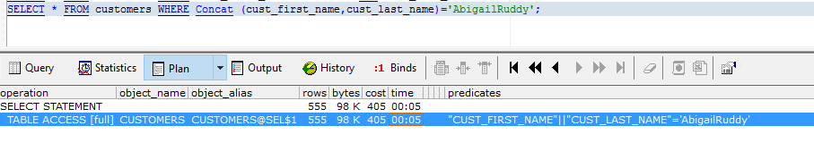
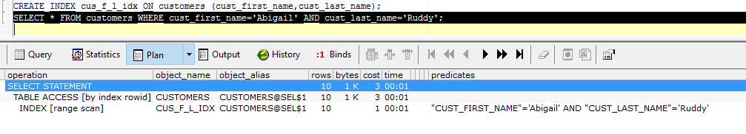
Index vs Search

Slide 29

Cost Vs Benefit

Slide 30
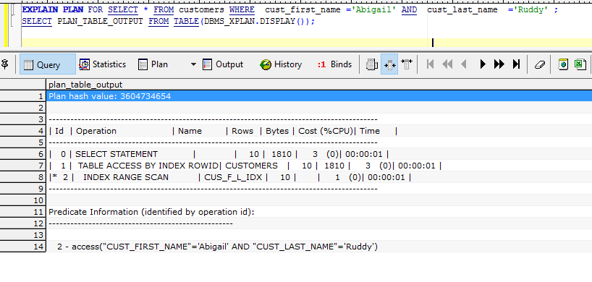
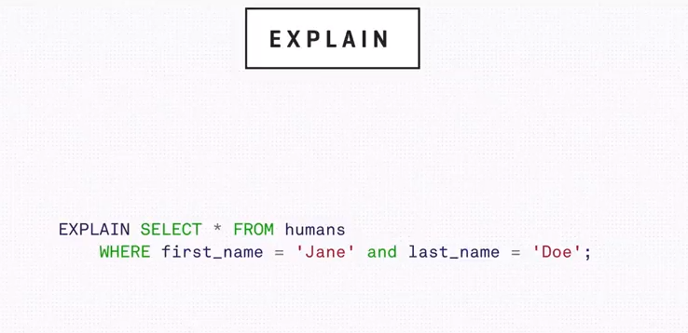
Explain

Slide 31
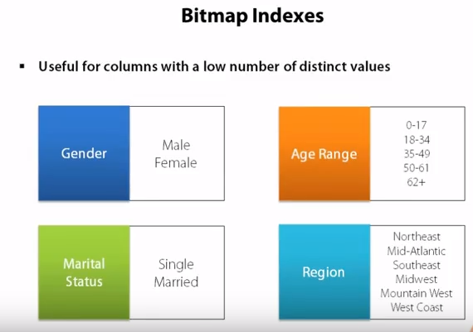
Bitmap index
A bitmap index is designed to solve a completely different type of problem and for that reason works very differently than a standard B Tree index

Slide 32
Bitmap Index
A bitmap index is designed for situations where you have low cardinality columns that is columns with just a few distinct values these columns such as gender or marital status we may have a value that defines the region that a customer's located in.
Finally consider the case where we have a column that maps to a predetermined set of bins.
An example of this is age where we might convert ages into a bin
That keeps track of who's between 18 and 34 ,35 to 49 and so on all of these are situations that a standard B tree index will not work very well in because of the low number of distinct values.

Slide 33
Bitmap Indexes simple example
In a bitmap index what Oracle is going to do is to construct a two-dimensional array for the data being indexed .
It is shown here there will be a row in the array for each row in the table.
Then for each distinct value contained in the column that we are indexing oracle will create a column in the array
From here Oracle simply marks a 1 or a 0 in the array element based on whether or not the condition is true
For this row so as we see here student this row so as we see here student id 1 0 0 1 is a female so the column labeled female in the bitmap indexes mark is true or 1 while the column male is marked as 0.

Slide 34
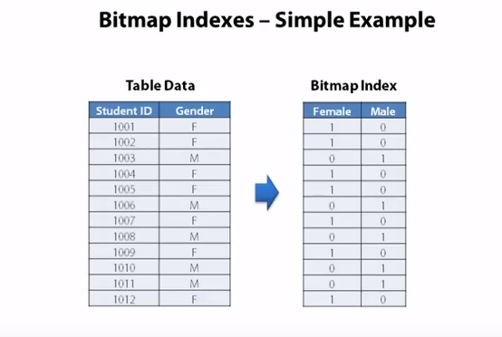
Simple example
Conversely we see that for student ID 1 0 0 3 who is a male and the female column is marked as 0 meaning false and the male column is marked as True so we have inner bitmap index is really just a two-dimensional array of bits .

Slide 35
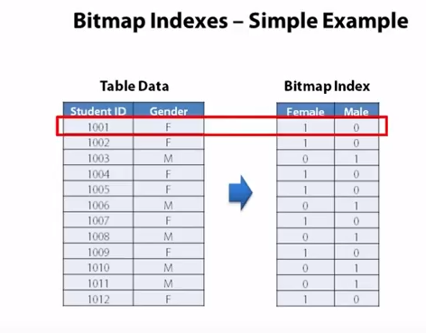
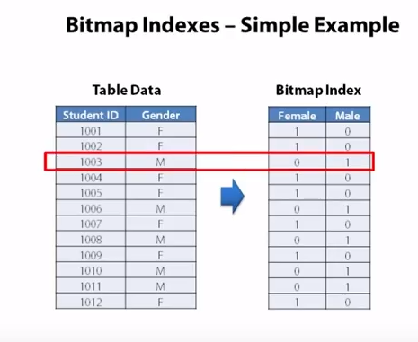
Simple example

Slide 36
Advantages
Other than the simplicity of this structure there are a couple of advantages to this.
First of all this structure is very space efficient on its own and secondly bit arrays like this can be highly compressed making structure even more space efficient.
Consequently that map indexes don't take up much space on disk and so they can be read very quickly by Oracle.

Slide 37
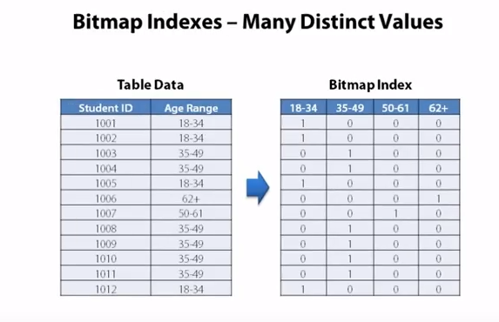
What if the column that we're indexing?

Slide 38
What if the column that we're indexing in our bitmap index has more than two distinct values?
That's okay what we're going to do is that we're just going to get more column in our bitmap array so as you see here we've probably done some bending on ages to convert them into age ranges and we have four different age range values in our table
Then translate these into four distinct columns in our bitmap index and so if we have a relatively low number of distinct values and consequently a low number of columns in our bitmap index.

Slide 39
We can then retain the advantages of the bitmap index in terms of being space efficient for storage and reading the index off of disk even if we have 50 or 100 or even a few hundred distinct values this is going to be okay.
But if we have a high number of distinct values several thousands or tens of thousands then we'll have to have the same number of columns in our bitmap index and those advantages go away this is one of the deciding factors in choosing between a standard b-tree index and a bitmap index.
So if you have a lot of unique values then a b-tree index is a better choice but for low cardinality columns that have just a few distinct values a bitmap index is a better choice.

Slide 40
Real power bitmap indexes
The real power of bitmap indexes comes when we can join several bitmap indexes together conducting bitwise logical operations between different bit arrays is very efficient.
So while none of our columns individually has a lot of uniqueness by having a bitmap index on each column and then connecting a logical and operation we can very easily answer questions like finding all the females who are married in the age range of 35 to 49 which is a typical demographic question that one might want to ask and again this is where bitmap indexs really shine
The standard B tree index just isn't a very good fit for this problem to get enough uniqueness
We'd have to include all the columns in the b-tree index but this index then will be targeted at just this one individual query
If we decided that we wanted to use some different demographic information let's say replacing the gender column with a column that reflected the highest level of education that this person has completed then the b-tree index would not work at all.

Slide 41
Real power bitmap indexes
By using a bitmap index it is possible and desirable to have many of these such indexes across various columns so we can easily perform these bitwise logical operations between the different bit arrays.
This is going to work very quickly and very well.

Slide 42
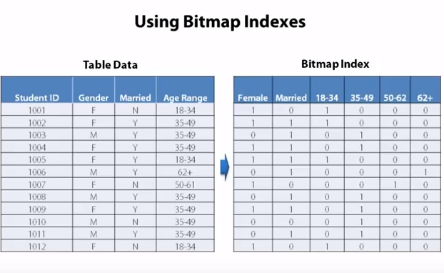
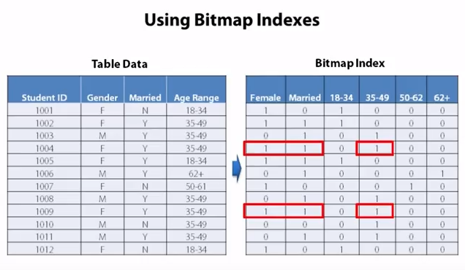
Real power bitmap indexes

Slide 43
Bitmap index usage
Bitmap indexes are designed for data warehousing environment.
It is a data warehouse environment that we often want to conduct these types of queries where we're aggregating data together and often we're trying to drill down on data by using a combination of these low cardinality columns so bitmap indexes help us solve that problem and they do it very efficiently .
However all bitmap indexes work well for a data warehouse they should never be used in an OLTP database anytime you perform any sort of DML against the column that the bitmap index is over.

Slide 44
Bitmap index usage
The process Oracle has to undergo to update the bitmap index is very expensive and very slow so bitmap indexes are not appropriate to use any database that does any sort of transactional processing which means pretty much any database used for a line of business application.
In a data warehouse environment or batch loading the data through some sort of ETL process you will be fine.
But if you try to use a bitmap index in a transactional database with any amount of inserts updates or deletes you will quickly find yourself in a deadlock scenario so don't use bitmap indexes in your transactional databases but reserve them for use in your data warehouse applications.

Slide 45
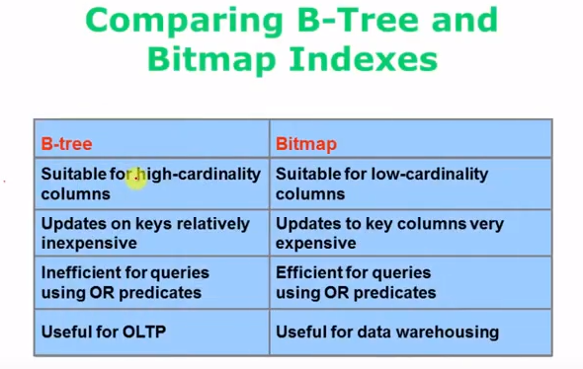
Btree vs Bitmap

